Slide 1
Determining the Influence of Papyrus Characteristics and Data Augmentation on Fragments Retrieval with Deep Metric Learning
Intro Talk Master Thesis Timo Bohnstedt, B. Sc.
Advisors Mathias Seuret, Dr.-Ing. Vincent Christlein
Prof. Dr.-Ing. habil. Andreas Maier
Institution Chair of Computer Science 5 (Pattern Recognition)
Friedrich-Alexander-Universität Erlangen-Nürnberg (FAU)

Slide 2

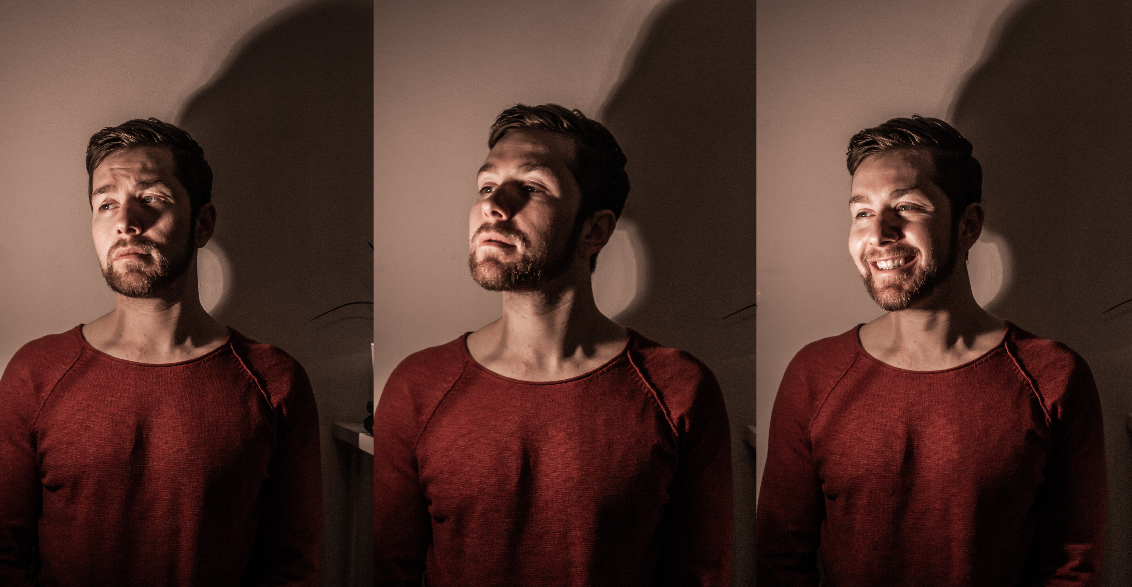
Timo Bohnstedt
Birthday 17.02.1992
Field of Study Computer Science, M.Sc.
Job Data Science @ Accenture
Residence Vienna
Extracurricular Hackathons, Mountaineering
Notes:
Ai is sneaking more and more into different industry fields with an increasing impact. For example in the educational sector, AI is already used as intelligent tutoring system, by tracking the childrens pupils and enhancing their concentration accordingly. Personally, I find the healthcare sector very interesting. Ai is already used for an improved diagnosis of diseases, for a faster process of drug research and approval and also for pattern recognition in genoms to identify potential risks for certain diseases.

Slide 3
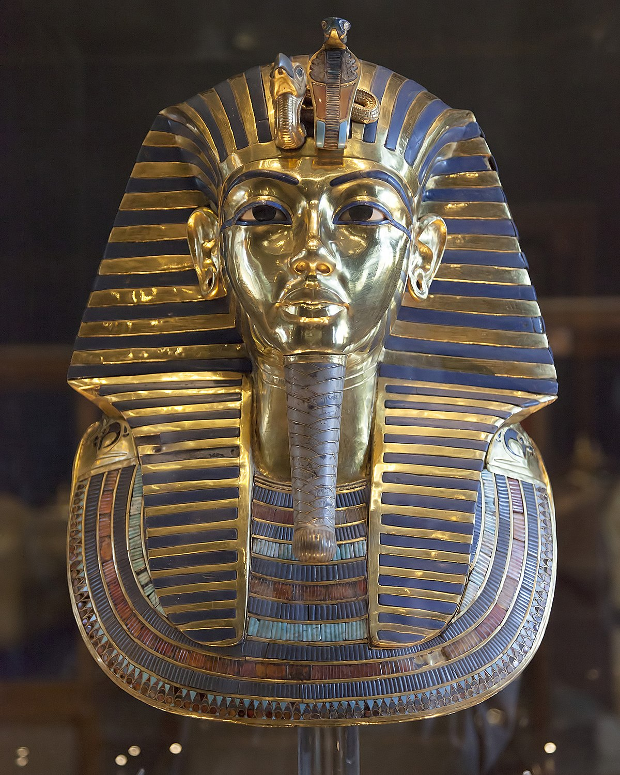
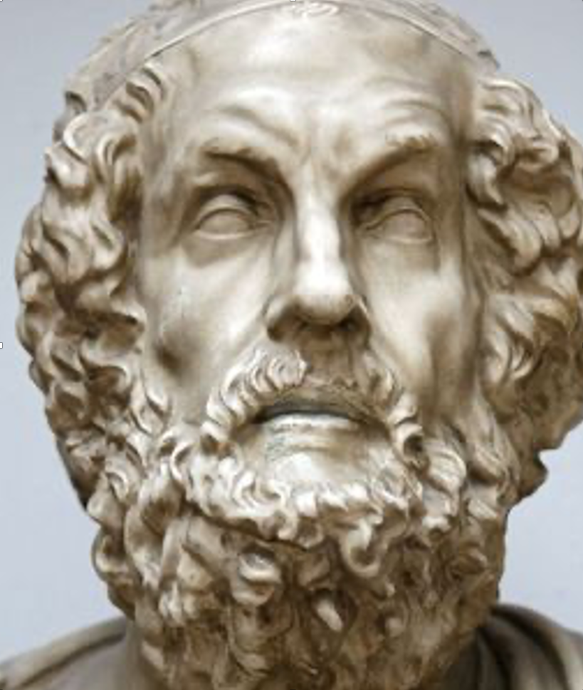
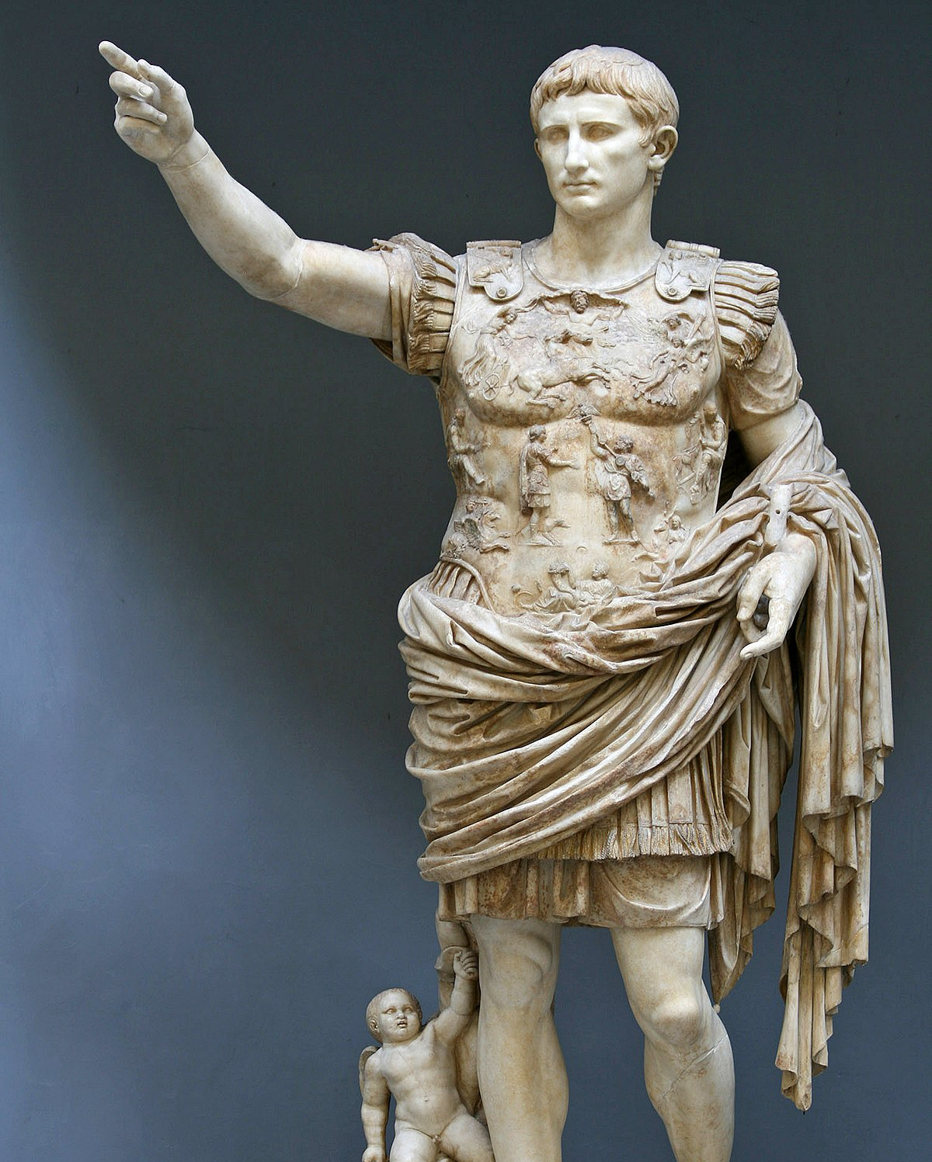
Motivation – Part I
Notes:
What do these three people have in common?
Tutankhamun, Homer, and Ceaser lived in vast empires with relatively large administrations.
Like today, such empires produce a vast amount of information.
All three empires used paper for a long time, obtained from the papyrus plant, so-called papyri, To preserve and distribute this information.
So whether Tutankhamun's order to build a pyramid, the Odyssey poem in Original or Ceaser's letters, much of it is recorded on papyrus.
Generally speaking, If we want to understand the history of these empires and their cultural heritage, it is crucial to evaluate this papyrus.
Paper made from papyrus was the chief writing material in ancient Egypt, was adopted by the Greeks, and was used extensively in the Roman Empire.
It was used not only for the production of books (in roll or scroll form) but also for correspondence and legal documents.

Slide 4
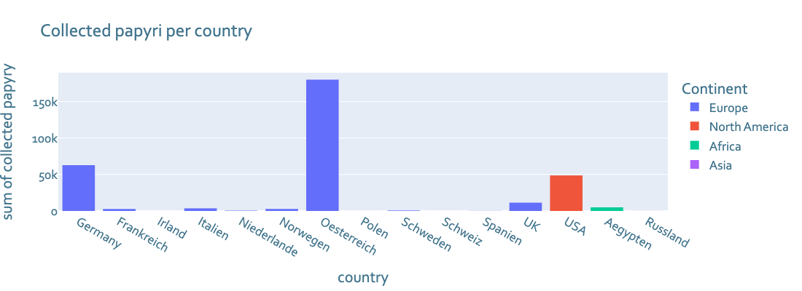
Motivation - Part II
Notes:
As you can see there is a large amount of papyrus (fragments) worldwide. Not all fragments have been assembled yet. As many of you probably know, it is extremely time consuming to assemble these fragments by hand.

Slide 5
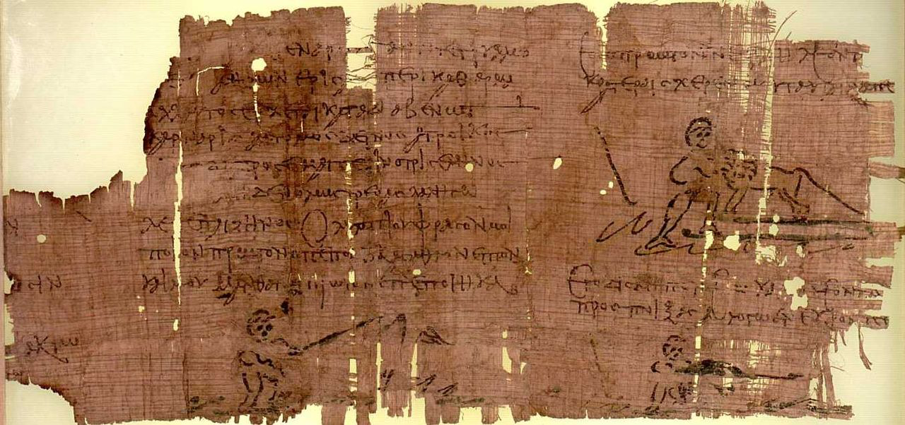
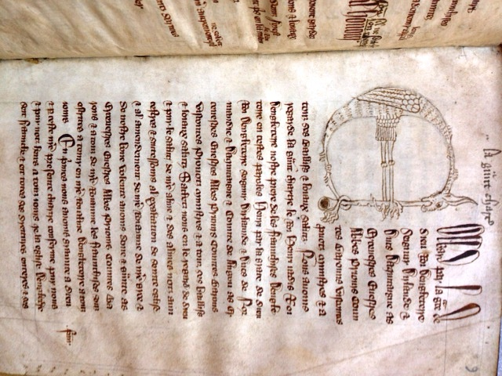
Motivation - Part III
Notes:
Papyrus is sensitive to mechanical stress, moisture, and worm damage, but basically exhibits surprisingly high durability. The way papyrus ages makes it particularly difficult to reassemble fragmented pieces. This is probably what distinguishes it most from other historical documents. This is also the reason why there is an increasing interest in such papyrus pieces among computer scientists working in the field of computer vision on cultural heritage.

Slide 6
Preprocessing - Part I
Notes:
As with many projects that deal with real data, a data set must first be created. For this, the natural fragments have to be separated. For this the fragments were separated into foreground and background with the help of a histogram. Through the separated image it was possible to recognize single fragments. Challenging were many small objects consisting of single or few pixels. The problem could be solved with a threshold and a little manual rework.

Slide 7
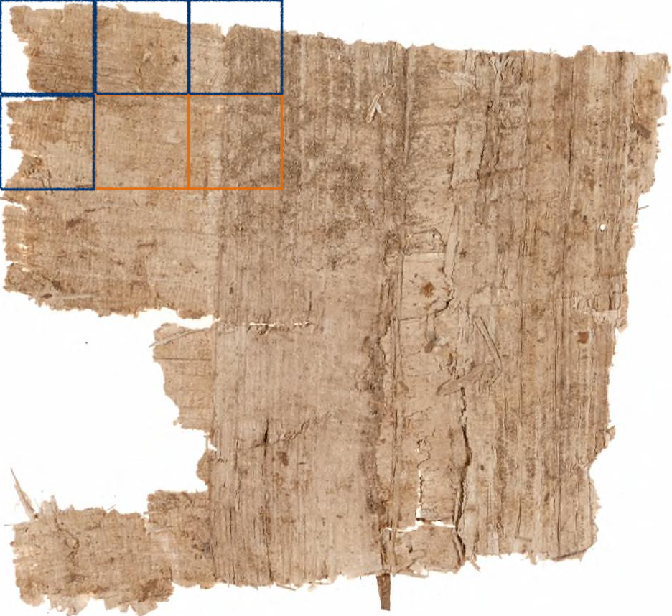
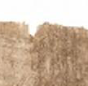
Preprocessing - Part II
Part I m x m non-overlapping patches
Part II find n useful patches via a metric
Part III go to part II
[4]
Notes:
For example apple podcasts. The amount of produced podcasts doubled within 3 years from 2018 to 2021.

Slide 8
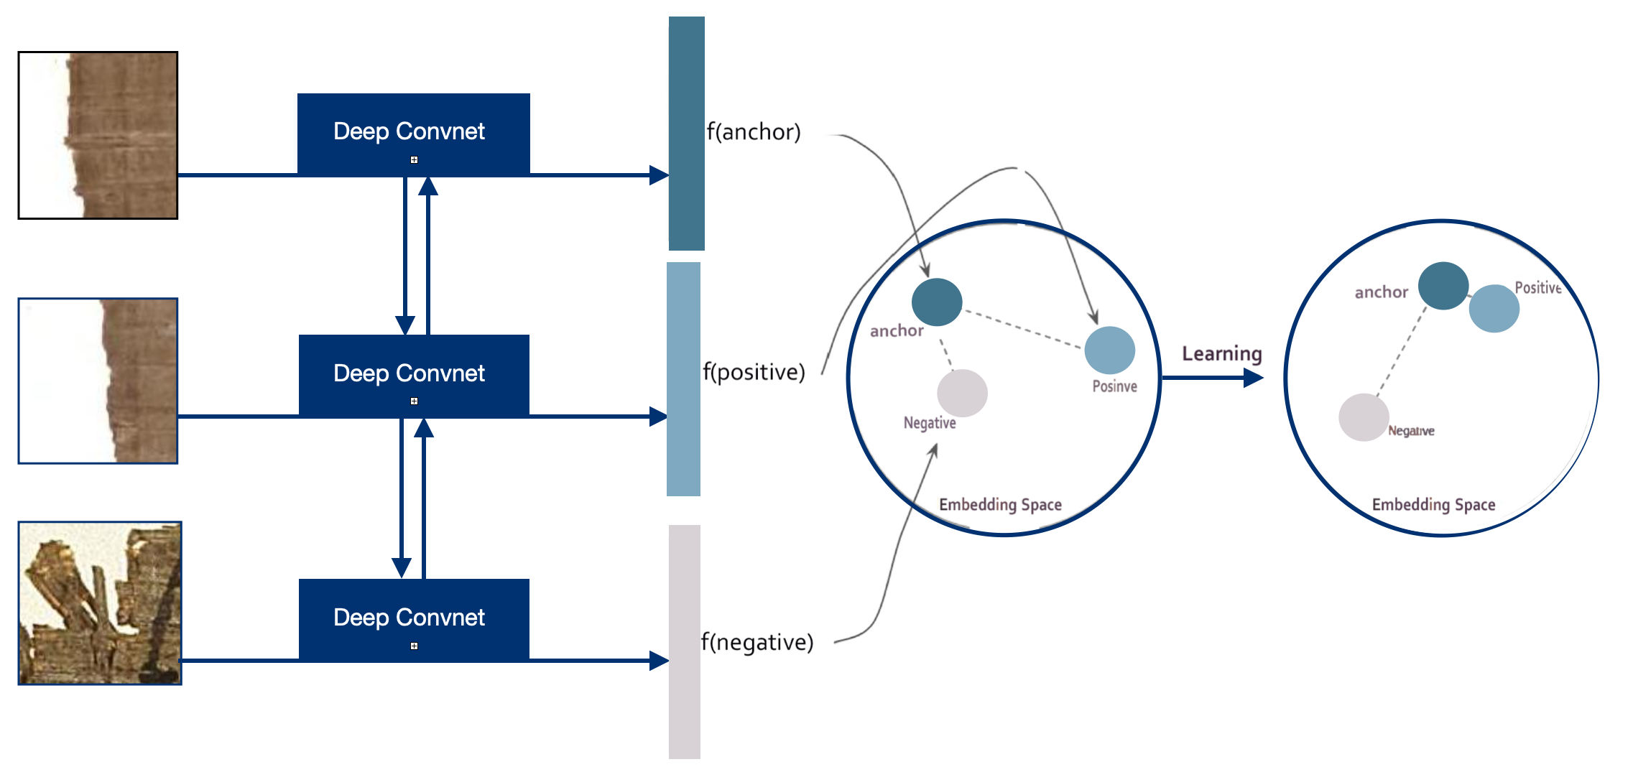
Modeling – Metric Learning

Slide 9
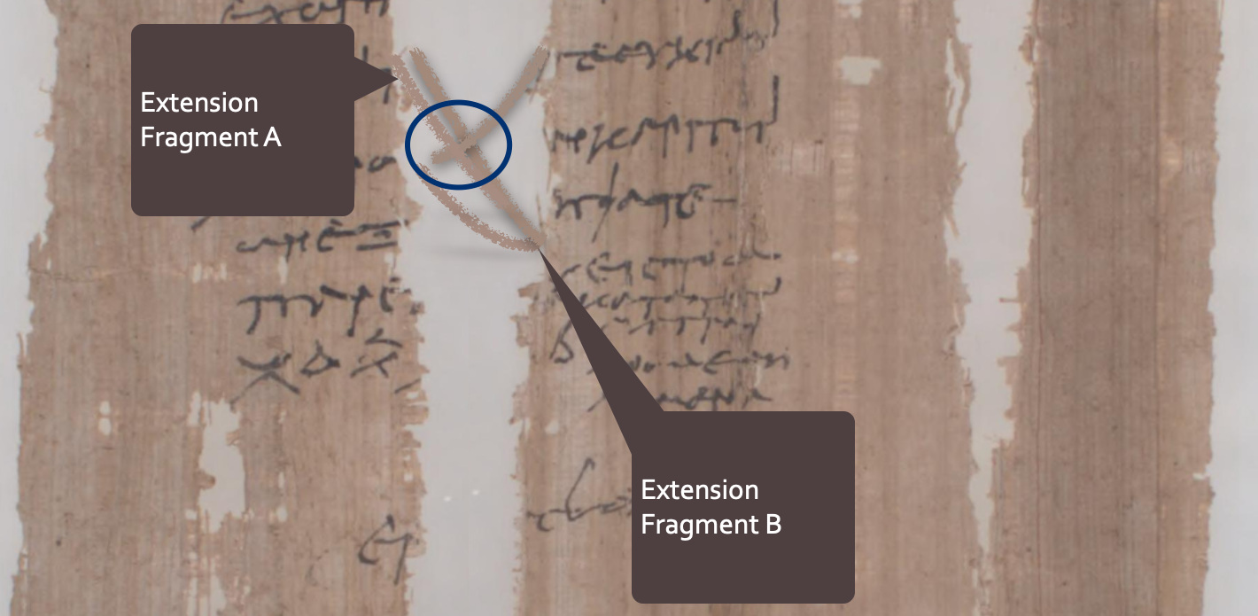
Modeling – Exploding Fibers
Part I Find Fibers
Part II Extend Fibers
Part III Match Fibers
Notes:
We now identified that podcast is a rich source of data with an increasing production rate. In order to make use of this huge amount of data, we first need to transcribe the voice into text. Only after having transcribed all of the voices into text files, we can make inference and predict future or past trends with the use of natural language processing.

Slide 10
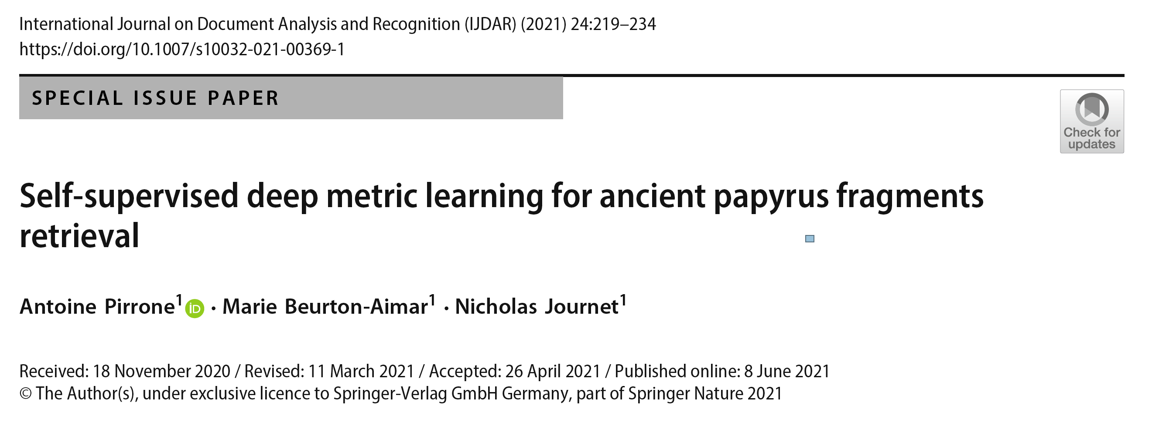
Related Work – Part l
[1]
Data
800 Fragmentes
Results
Top-1 Accuracy score of 0.73
Date
Nov.2020 to June.2021
Research Gap
Complete reconstruction of the Fragments
Using information of fragment-patches to assign labels to edges representing the spatial relationships between pairs.
Different effects of different parts of the image (text, fibers, foreground, etc. )

Slide 11
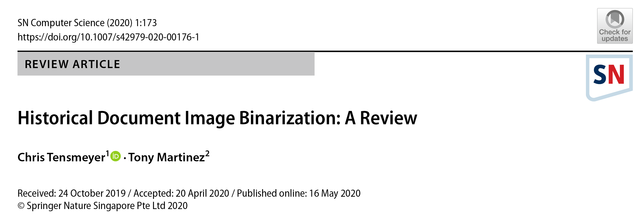
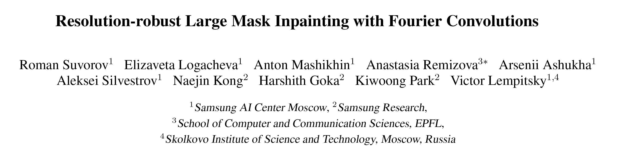
Related Work – Part ll
Binarization
[2]
Inpainting
[3]
State of the Art when it comes to inpainting
Uses extensive training and huge pipeline to be able to replace hart to detect objects
Used to replace text with fibers
Review of Binarization techniques for Historical Documents
Pointing out trend towards papyri

Slide 12
Research Questions
RQ 1 Does the puzzle-helpers-accuracy differ significantly when only the text or only the fibers are used as input as opposed to the unprocessed data?
RQ 2 With the help of papyrus fibers, is it possible to determine the position of a fragment out of several matching candidates?
Notes:
My research questions can therefore be concluded into

Slide 13
References
[1] Antoine Pirrone, Marie Beurton-Aimar & Nicholas Journet : Self-supervised deep metric learning for ancient papyrus fragments retrieval https://link.springer.com/article/10.1007/s10032-021-00369-1, June 2021, accessed: 2022.1.12
[2] Chris Tensmeyer, Tony Martinez: Historical Document Image Binarization: A Review, https://link.springer.com/article/10.1007/s42979-020-00176-1, May 2020, accessed: 2022.1.12
[3] Roman Suvorov, Elizaveta Logacheva, Anton Mashikhin, Anastasia Remizova:
Resolution-robust Large Mask Inpainting with Fourier Convolutions, , Sep 2021, accessed: 2022.1.12

Slide 14
Summary
Milestone I Create a (public) dataset
Milestone II Use Deep Metric Learning to retrieve Fragments
Milestone III Extend Fibers and retrieve better Fragments and their position
Notes:
Thanks & Questions?!

